Slide 1
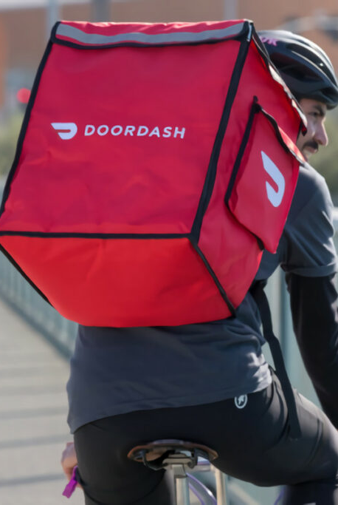
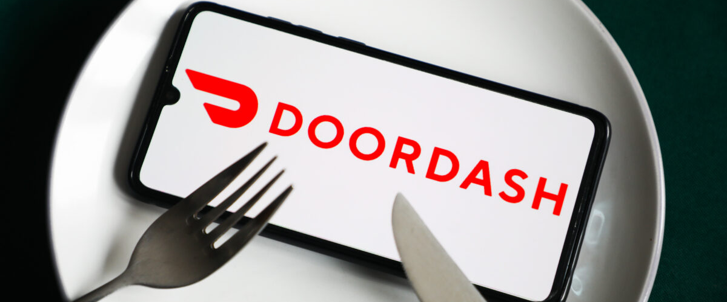
DoorDash: Growth through Acquisition
Hanna Daminski, Rachel Hagerman, Jenifer Jackson, Andrew Mcleod, & Bryce Bowles
Notes:
https://cdn.vox-cdn.com/thumbor/uCPCbH8hlweT2peo5fv_J2d0TXI=/0x0:1528x798/1200x800/filters:focal(329x193:573x437)/cdn.vox-cdn.com/uploads/chorus_image/image/64799824/doordash_delivery_worker.0.0.png
https://specials-images.forbesimg.com/imageserve/604f034d6cdc3c5c3e72a237/960x0.jpg?fit=scale

Slide 2
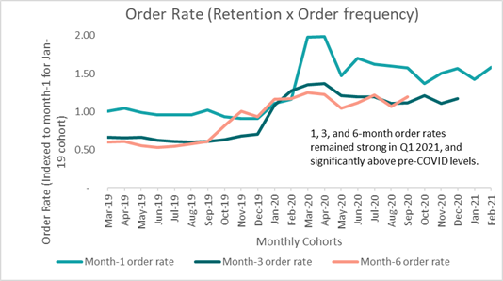
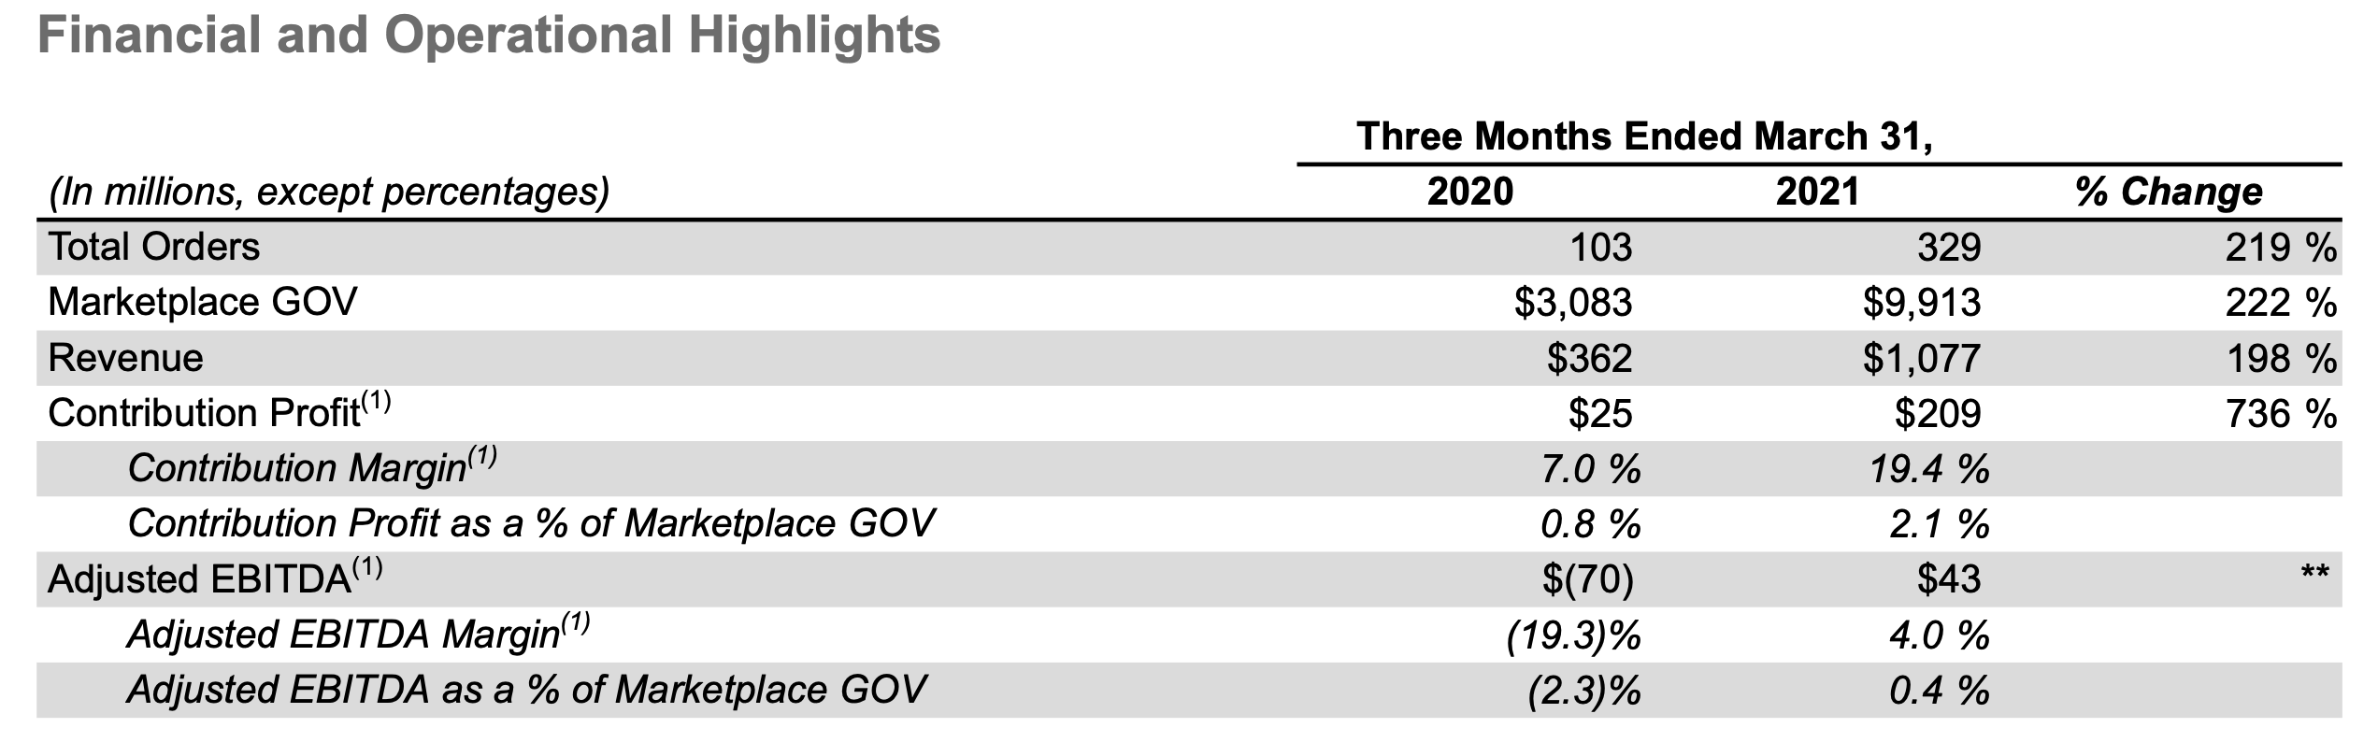
DoorDash 2021 Q1 Performance
Operational Performance
Average order rate among existing consumers increased both Q/Q and Y/Y, )
New consumer cohorts order with more frequency than pre-COVID-19 pandemic historical averages
DoorDash acquired new consumers at a pace that was consistent with the prior two quarters.
DoorDash more than doubled DashPass subscribers Y/Y and drove DashPass average order frequency for the quarter to an all-time high since launch.
Financial Performance
Q1 net loss of $110 million or 34 cents per share
In Q1 2021, Door Dash grew Total Orders 219% Y/Y to 329 million.
Strong growth in Drive revenue drove Q1 2021 revenue up 198% Y/Y to $1.1 billion.
Q1 2021 Marketplace gross order value (GOV) grew 222% Y/Y to $9.9 billion.
Adjusted Gross Profit declined to 5.3% in Q1 2021 versus 6.6% in Q4 2020 and 5.6% in Q1 2020

Slide 3
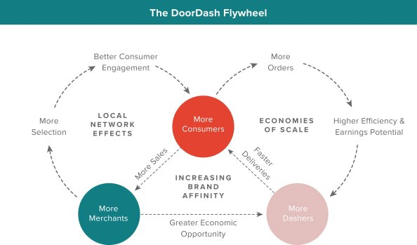
DoorDash Growth Strategies
Organic Growth Strategies:
2016 - DoorDash Drive: Large ordering/nonfood items
April 24, 2018 – Walmart Partnership (Grocery and non-Food Items)
Aug 5, 2020 - DashMart (convenience/grocery items)
Oct, 2020 – Macy’s (Department store items)
Expands Globally: April 30, 2021 (Europe and Japan)
Tactics:
Developed a detailed playbook for rolling out a new market
Guidelines on how to approach merchants
Checklists of what needs to be done when
Provides education for merchants, e.g. how to optimize their dishes for delivery and pick-up, or what to do to attract new customers.
Three core elements: More order volume = Everybody wins
Acquire more merchants and empower them with more merchant services that help them grow their business
Acquire more customers and offer them a restaurant selection and services that drive up engagement and retention
Empower dashers with an efficient delivery process so they can deliver more orders per unit of time, with a predictable, transparent way to earn money
Creates economic uplift for all participants
Inorganic Growth Strategies:
Jan 2019: General Motors partnership - Self-Driving Cars
Scotty Labs (Aug 2019 - self-driving and remote-controlled vehicle technology)
Caviar (Oct 2019 - upscale urban-area restaurant delivery)
Chowbotics (Feb 2021 - food prep automation)
Notes:
Doordash has many organic and inorganic growth strategies they have implemented over time
As you know, DoorDash and all of food delivery is operating on thin margins so higher quantity or volume benefits
The Consumers, Merchants and even drivers (shown in picture on the left)
Some Organic growth Strategies are
Non-food items
Doordash Drive
DashMart
Walmart
Macys
Expanding Globally
And also creating tactics such as
rolling out a new market
Provides education for merchants, how to be more efficient
Or how to attract new customers.
And some Inorganic Growth Strategies are:
Jan 2019: General Motors partnership - Self-Driving Cars
Scotty Labs (Aug 2019 - self-driving and remote-controlled vehicle technology)
Caviar (Oct 2019 - upscale urban-area restaurant delivery)
Chowbotics (Feb 2021 - food prep automation)

Slide 4
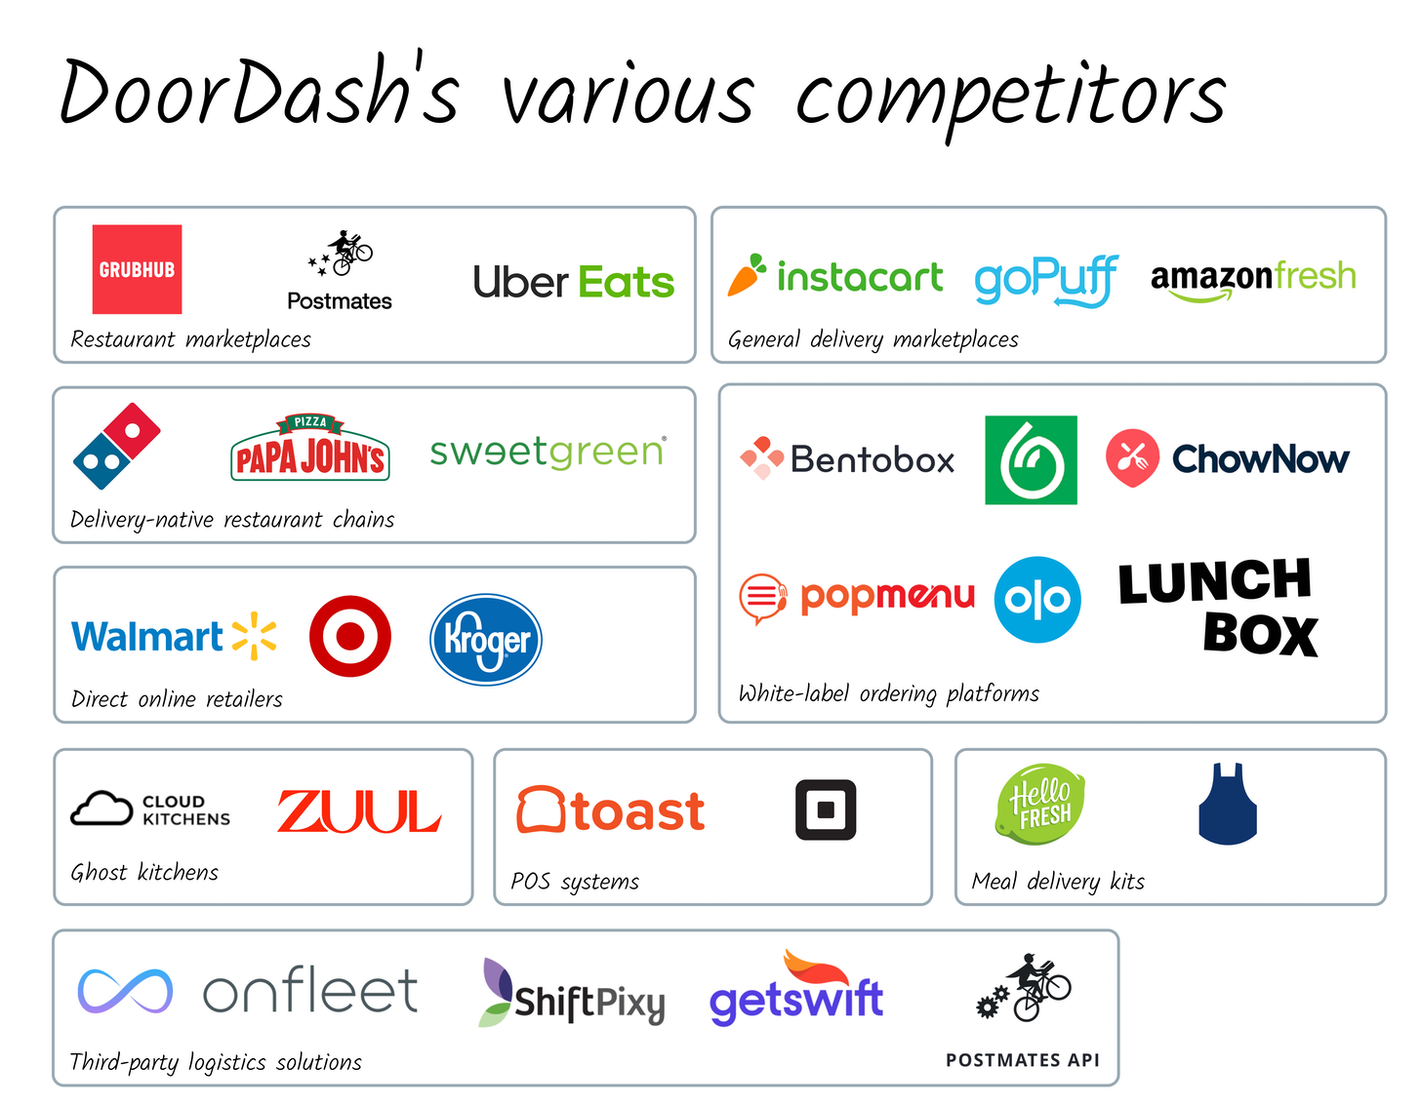
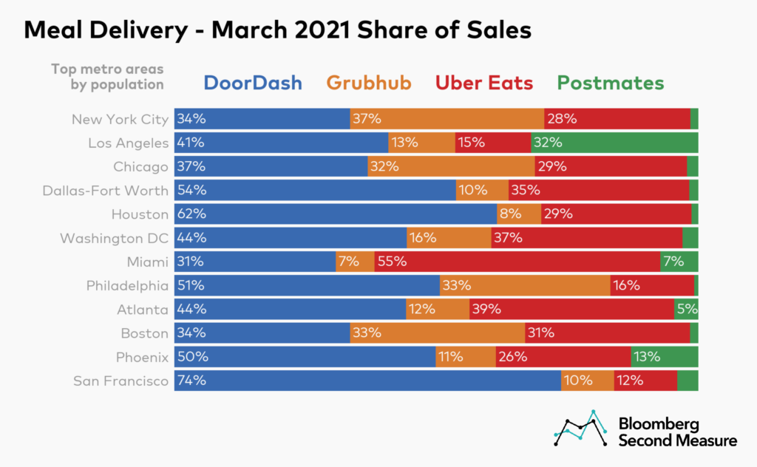
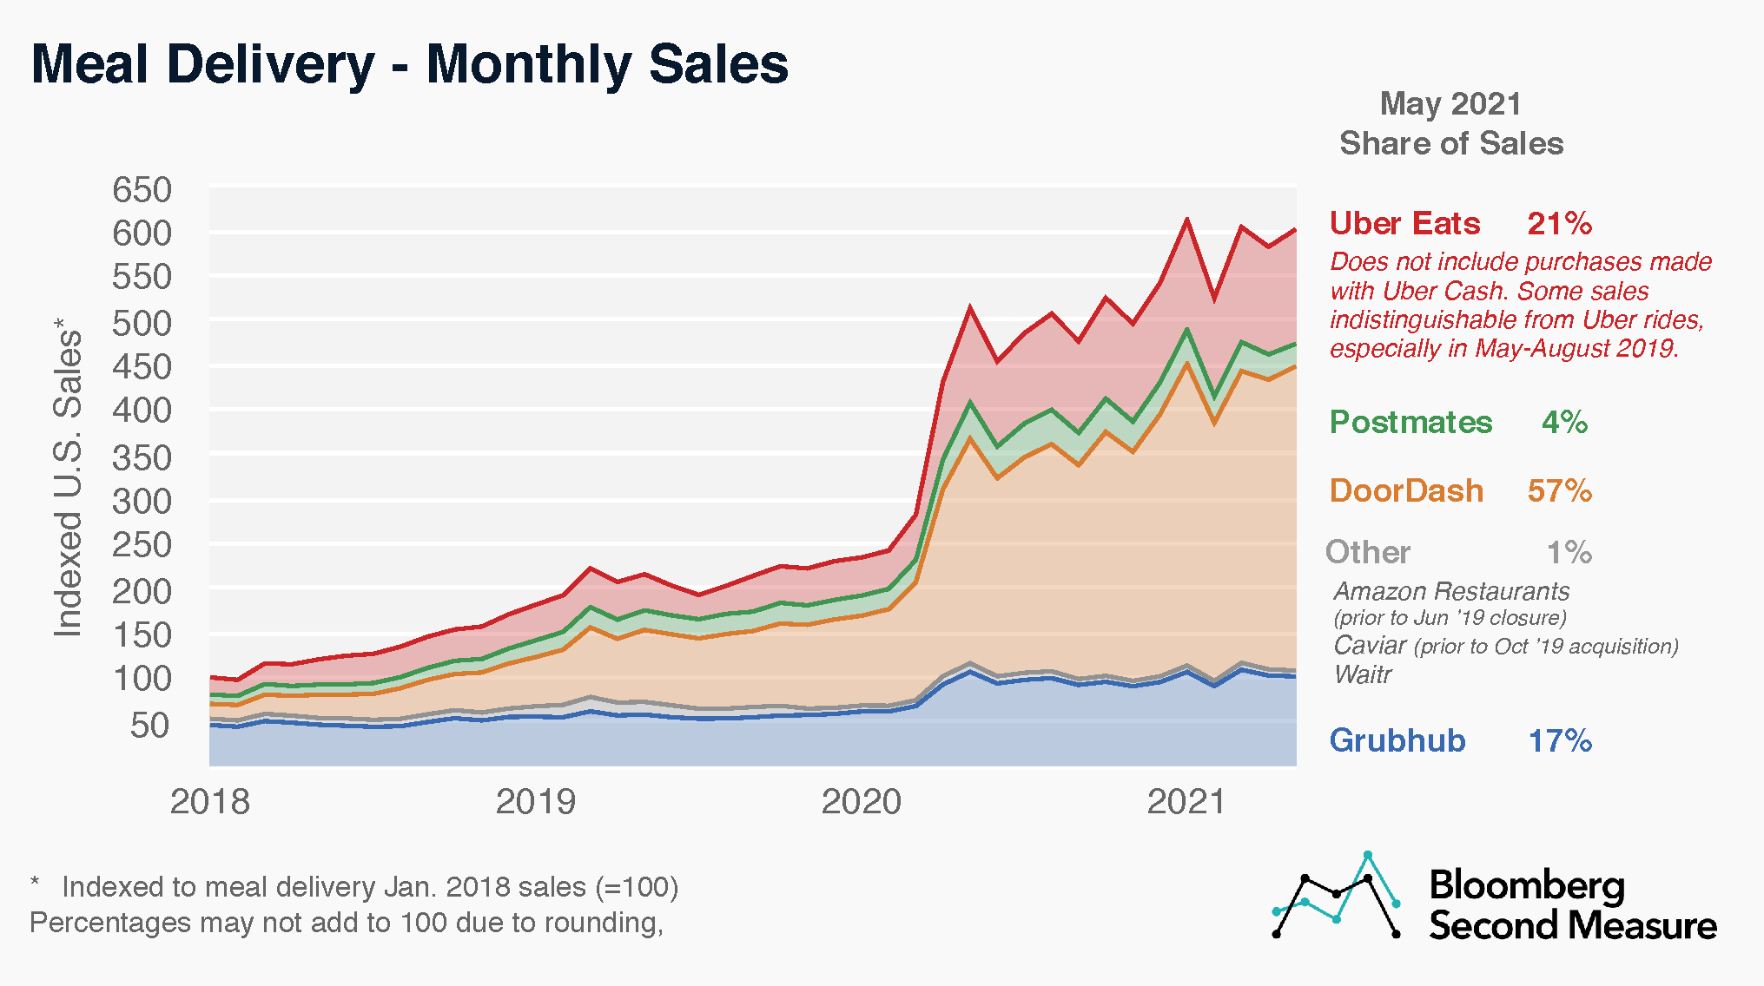
Competitive Assessment of DoorDash Market Space
DoorDash cites its US market share at 50%, with greater penetration in suburban markets.
Second graph broadly confirms this assertion, suggesting that DoorDash held 57% of the market as of May 2021.
Doordash Competes with other marketplace companies, grocery delivery services, meal kits, ghost kitchens, and vertically integrated restaurant chains.
DoorDash looks to empower small and medium sized businesses and expand its logistical operations, by competing with white-label ordering platforms, POS systems, third-party logistics providers, and direct online retailers.
Notes:
I recommend moving the "various competitors" to last then you can say that traditionally it was these people (grub, uber) but as they diversify it becomes all of these
Thanks

Slide 5
DoorDash Vision Statement & Proposed Growth Strategies
DoorDash Vision Statement
“Our vision - which will take decades to realize - is to build a last-mile logistics platform, create a set of services to grow a merchants sales, and produce a membership program that connects consumers to the merchants that sustain them”
Proposed Growth Strategies
Improve Customer Satisfaction
Grow Market Share through Improved Relationships with Suppliers
Diversification of Services through Increased Retail Partnerships
“Underpenetration of e-commerce in the foodservice space provides the biggest tailwind for the company” – DoorDash President
Notes:
Last week we presented 3 potential growth strategies based on our SWOT analysis of DoorDash. They are: Improved Customer Service specifically through adding a satisfaction guarantee and training. Growing market share through improved relationships with suppliers, and diversification of services through increases retail partnerships which included a tactic around last mile delivery.
Today we are going to review three possible acquisitions that would help DoorDash implement, and be successful with, these strategies. At the top of your screen you will see DoorDash’s vision statement of ““Our vision - which will take decades to realize - is to build a last-mile logistics platform, create a set of services to grow a merchants sales, and produce a membership program that connects consumers to the merchants that sustain them.“ we would like you to keep this in mind while we propose each acquision offer.

Slide 6

Strategy: Grow Market Share through Improved Relationships with Restaurants
Strategy Goals: To gain share from the “Buy Local” consumer segment, shift share from other delivery services, and reduce the odds of new local competition entering the market
In our survey of 333 Richmond residents, 35% of those preferring curbside, and 88% of those preferring local delivery, said that “supporting local” or “better for restaurants” was a motivation. We believe restaurants have influence over these customers. Nationally published surveys and research show similar results
States are making it illegal to list a restaurant on 3rd party delivery sites without restaurant permission making the relationship with restaurants more important. DoorDash needs to act quickly to keep restaurants on their site
DoorDash forming strong relationships with restaurants, and adding value to their business proposition, could prevent a new local delivery service from entering the market or prevent restaurant owners from forming a local coop food delivery service
Tactic: Monthly Cash Back Program (DashBack) for restaurants
Rewards restaurants for increasing the number of orders through DoorDash by returning a growing portion of their commissions monthly, based on order volume
Motivates restaurants to support DoorDash without removing their ability to get exposure, and additional orders, from other sites. By listing only DoorDash on their website, menu, and social media, share will shift from other 3rd party sites to DoorDash
We're there for you 24/7/365 for live chat, email, and phone support. Use your DoorDash
Tablet and POS integrations to fulfill orders with your back of house, and the Merchant
Portal to manage your menu, analyze sales, and respond to customer ratings.
Notes:
Our first option, which I will introduce on the next slide, connects with the strategy of “grow market share through improved relationships with restaurants.” Our survey and research showed us that the relationship with restaurants was key to gaining share with the “buy local” consumer segment for several reasons. 1) In our survey, a large portion of respondents cited they were picking up orders curbside, or using a local delivery company, because they thought it was “better for restaurants.” 2) With states passing legislation requiring 3rd party services to remove all restaurants without contracts from their websites, DoorDash needs to be proactive and form, or strengthen, their current relationship with restaurants. 3) many local delivery services, or franchised local coops, are springing up around the country, including Richmond, that are backed by restaurant owners. If DoorDash could strengthen relationships with restaurants, these could be prevented. To support our strategy goals to “gain share from the “Buy Local” consumer segment, shift share from other delivery services, and reduce the odds of new local competition entering the market” – we recommended a monthly cash back program for restaurants. This program rewards restaurants for increasing the number of orders placed through Doordash with a portion of their commissions returned by check monthly. This motivates restaurants to encourage their customers to order through DoorDash.
After recommending the Dashback program, we thought “what else can DoorDash do to strengthen their bond with restaurants?” We knew they are already offering extensive training to restaurants, have 24/7/365 chat, email, and phone support for restaurants, have a Merchant Portal for restaurants to manage their menu, analyze doordash sales, and respond to doordash customer ratings, and they integrate into most restaurants point of sale systems either directly or through an intermediary. And that last part was our Eureka moment (tie to boxes book). We remembered our research that ~70% of restaurants added curbside pickup and ~40% added online ordering in 2020 and asked ourselves “How did they do it?”

Slide 7
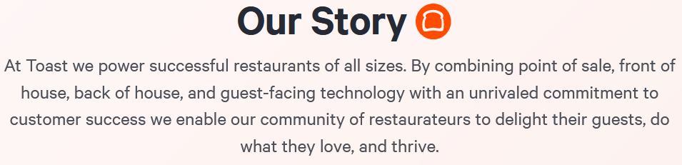
Who is Toast?
Toast Company History:
2011: Founded in Cambridge MA.
2013: First Restaurant goes live
2014: Introduces integrated online ordering, gift cards, loyalty, and kitchen display systems
2017: In all 50 states. Named 3rd fastest growing technology company in North America by Deloitte
April 2018: Introduces ToastGo, the first handheld POS system designed specifically for the restaurant industry (Android)
June 2018: Becomes the leading cloud-based restaurant management platform
April 2020: Cut half their staff in reaction to pandemic
November 2020: Valuation nearly doubles pre-pandemic value due to restaurants retooling for takeout
2021: Named top restaurant POS by G2
Toast is a Cloud-Based Restaurant Software Company that combines all the software needed to manage a restaurant into their POS system.
Front of House: POS with ticket and table management, ToastGo, Kiosk
Back of House: kitchen display system (no paper tickets), inventory management
Online Ordering: including the ability to create a no-contact guest experience
CRM: email marketing, loyalty, gift cards
Back Office: payroll, analytics, payment processing
Restaurants can use Toast to get online orders without having a POS or buying the Toast POS.
Notes:
There are many companies out there vying to help restaurants add online ordering. Some allow restaurants to add an "order now" button to their existing website so they can accept pickup orders. There are companies, including DoorDash, that will allow that same button for pickup but also enable delivery through their company. Then are still other companies that offer an entire suite of services with online ordering being just one part. Toast is an example. Toast is a cloud-based restaurant software company that combines all the software needed to manage a restaurant. Before I talk about everything the Toast point of sale system can do, let's look at a brief history. Toast was founded in 2011 in Cambridge Massachusetts though they are currently in Boston. Originally, the company created a mobile payment app that would interface into a restaurants POS system to cut down the wait time for customers when closing their restaurant tab. This app also tied to loyalty programs, promotions, and socials. The product failed due to difficulty connecting to legacy POS systems and their overestimation of customers willingness to download an app to save a few minutes. They decided there was opportunity to create a full restaurant technology platform that was easy to deploy, could be accessed from anywhere, and intuitive to use. The first restaurant goes live on their cloud based, and Android built, POS in 2013 and they had 1000 merchants within 2 years. In 2017 they added their 50th state and were named the 3rd fastest growing technology company in north america by Deloitte. They now have an office in Dublin Ireland too. In 2018 they introduce the first handheld POS system designed specifically for the restaurant industry, ToastGo and they become the leading cloud-based restaurant management platform. When the pandemic hit, they laid off half of their staff but they quickly bounced back as restaurants pivoted to add curbside and needed a partner. By November 2020 their valuation was nearly doubled the estimate pre-pandemic. In 2021 they were named top restaurant POS by G2. If you have never worked in retail, hotels, or restaurants, you may never have used a POS but you can think of it as the modern day cash register or what a cashier uses to ring up your groceries but these systems get more advanced daily. In the Toast system the front of house can input a order, the order shows up on the kitchen display system, the items used for the order are removed from inventory counts, at the end of night the back of house can submit payment processing and run analytics on the day, and the CRM system can send an email thanking your guests for visiting. Plus the system can be used for a no-contact guest experience and payroll is even integrated through a company Toast purchased. It is a all in one restaurant management solution.

Slide 8

Why Toast?
Adjacencies: Toast has products adjacent to DoorDash’s
Ability to Cross-sell and Grow Market Share: Toast customers are all potential DoorDash suppliers (40,000 and growing) and DoorDash's (restaurant) suppliers are potential Toast customers
DoorDash needs to earn restaurants trust and Toast has their trust. 1 in 5 new Toast customers is a referral from an existing customer. In December the DoorDash CEO wrote "We've heard the feedback and know we have to make improvements to earn and maintain partner trust."
Revenue and Cost Synergies: An example is a combined sales department to target new restaurants
Acquire Expertise and Technology: They are both technology companies with strong analytics
Reduce potential competition: Toast is competing with DoorDash’s Storefront by enabling restaurants to add online ordering to their own website and recently added delivery to that product (using DoorDash). However, they could expand further into DoorDash’s core market
DoorDash wants to improve their NPS. Toast has an NPS of 27 compared to DoorDash’s 5.
Toast has a strong culture which DoorDash struggles with but needs to improve
Shared Values: Both DoorDash (Project Dash) and Toast (Toast.org) have programs geared towards addressing critical food issues in communities
Restaurants like the ease of use compared to other POS systems which is important given the high industry turnover. DoorDash already integrates with Toast
The fastest growing restaurant management platform in North America
Notes:
So why should DoorDash purchase Toast? Adjacencies. Toast products are adjacent to DoorDash’s. This gives DoorDash the ability to cross sell and grow market share since Toast’s customers are potential DoorDash suppliers and DoorDash suppliers are potential Toast customers. Toast has a strong relationship that can help get DoorDash in the door to meet with customers. In fact, 1 in 5 new Toast customers comes from a recommendation from an existing customer. DoorDash, on the other hand is looking to improve relationships with restaurants. In his end of 2020 letter the DoorDash CEO acknowledged “that they need to make improvements to earn and maintain partner trust." One example of synergies is one Sales person can target restaurants to sell both sets of products but there are other potential revenue and cost synergies. Acquiring expertise and technology is another advantage to both companies as they are both technology companies with strong analytics. Reduce potential competition: Toast is competing with DoorDash’s Storefront. Both enable restaurants to add online ordering to their own website. Toast recently added delivery to that product but they are secretly using DoorDash. However, they could expand further into DoorDash’s core market
DoorDash is looking to improve their net promotor score with customers and their staff culture. Toast is strong in both of these. Plus the companies have shared values to help their communities. Lastly, restaurants like Toast and it already integrates with DoorDash. for these reasons, Toast is a great fit for DoorDash. Rachel
Not script – just notes: Toast is still small in the overall restaurant industry but a leader in cloud based. As restaurants ditch their antiquated systems and upgrade then their share will grow. Restaurants are not going to upgrade until they need to especially in the current economy but Toast has to edge for new restaurants or restaurants adding online ordering.

Slide 9

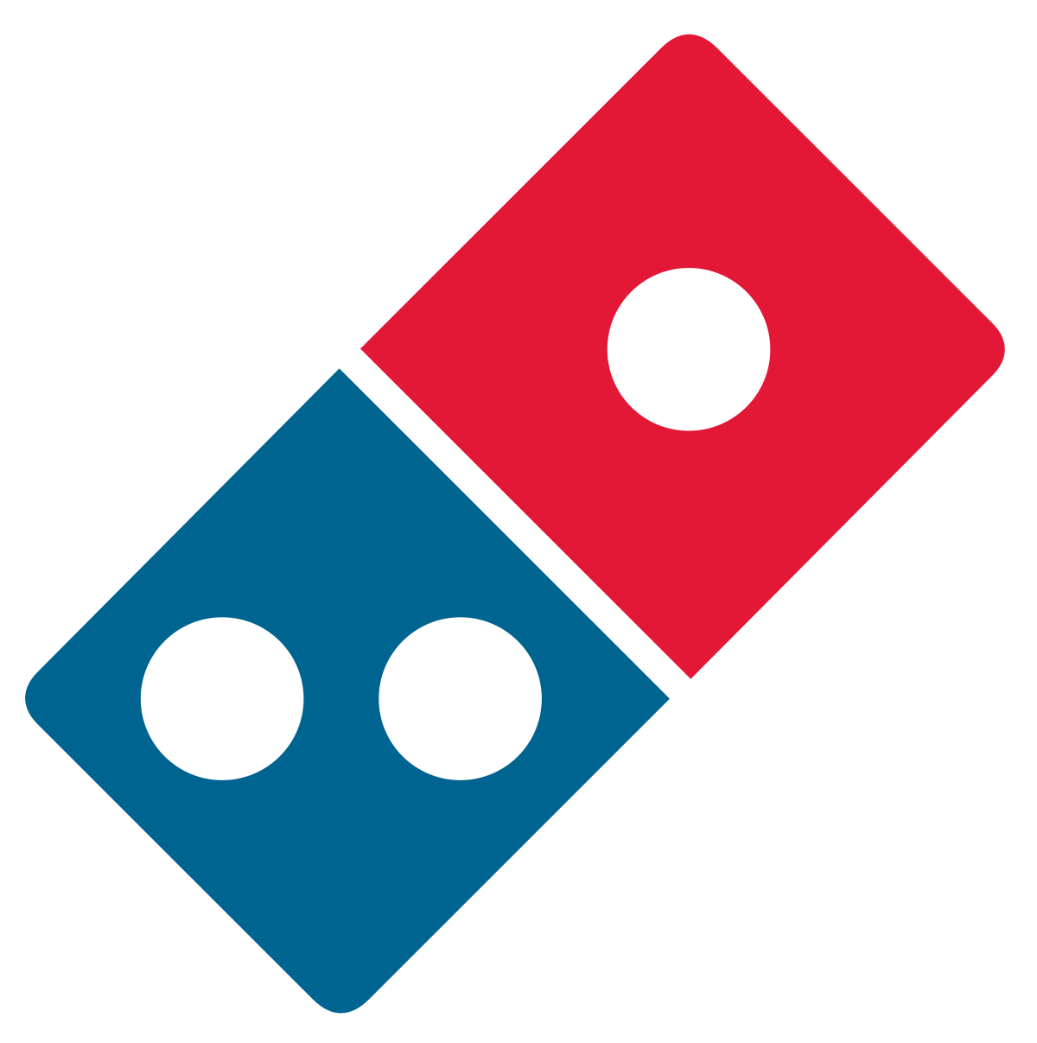

Acquistion Option: Dominos
Domino's Timeline
1960
Domino's Founded
1985
Domino's became the fastest-growing pizza restaurant in the US
1996
Domino's launched it's website
2007
Domino's launches online ordering
2012
Domino's launched its mobile app
2019
Domino's partnered with Nuro
Who is Domino's?
It is a leading pizza delivery company. Domino's operates a network of company-owned and franchise-owned stores in the United States as well as international markets. In 2020 Domino's generated $491 million in profits.
Reasons for Acquistion Consideration
Domino's shared vision of autonomous vehicle delivery
Domino's international footprint
Notes:
For first item: instead of "use of" -- Shared vision for last mile delivery would allow for shared R&D costs (use of or R&D of)
________________________________________________________________________________________

Slide 10
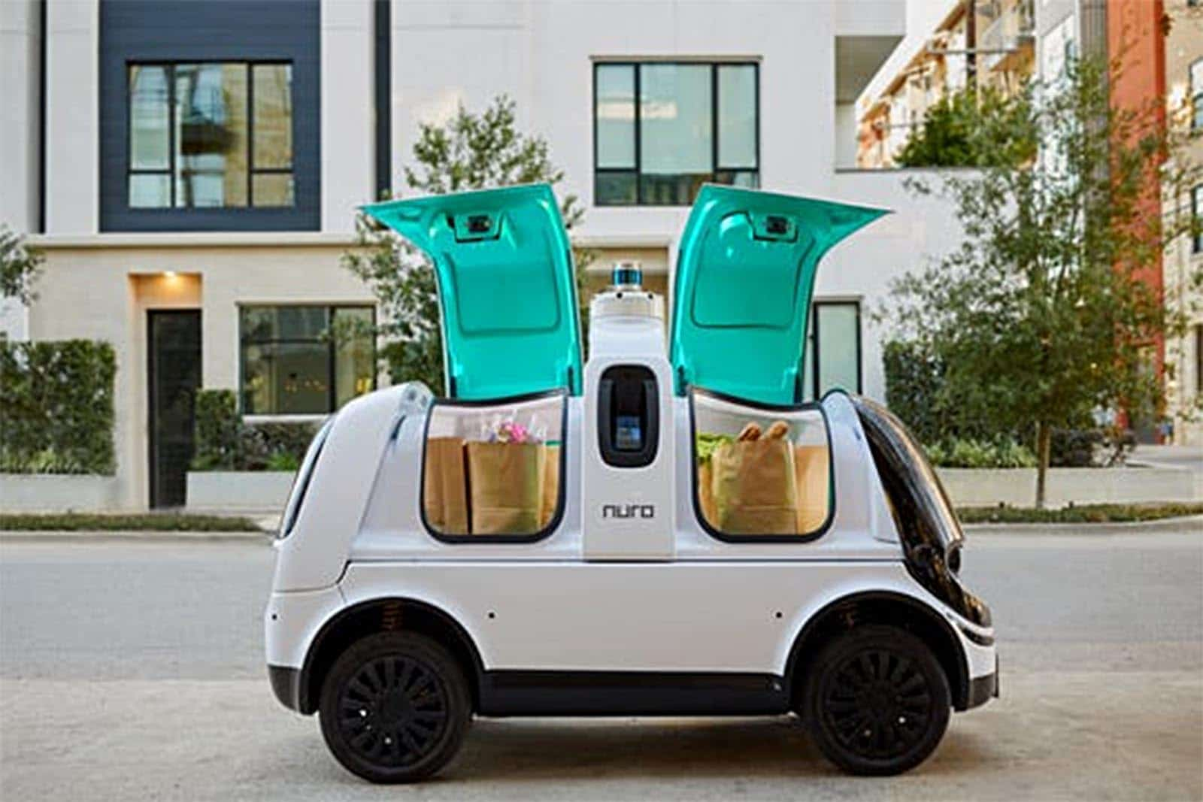
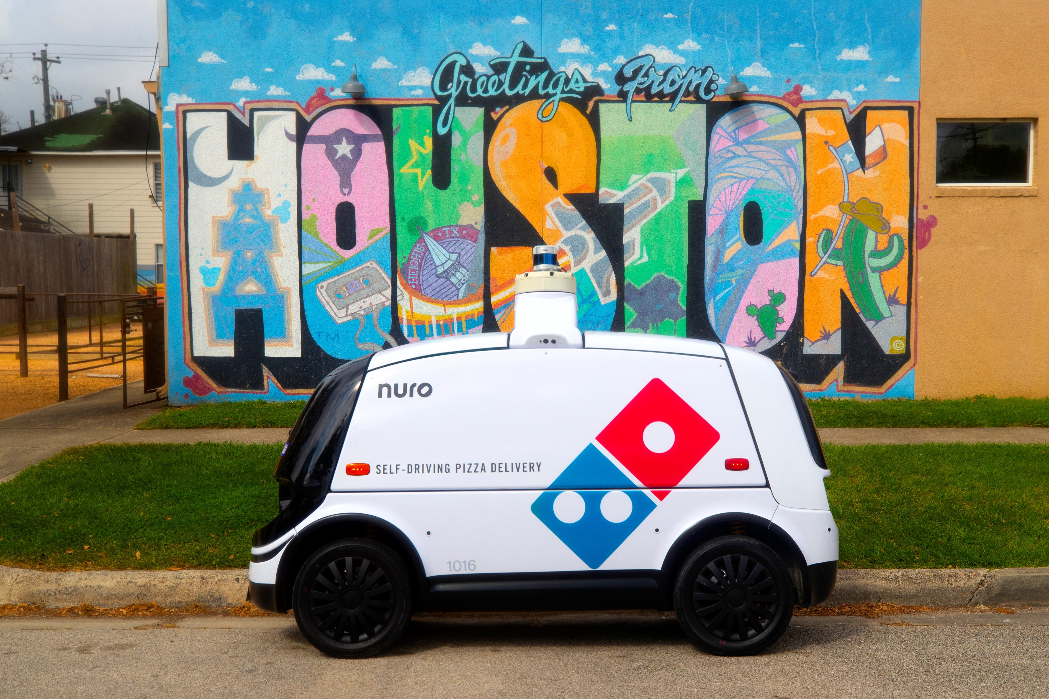
Domino's Autonomous Delivery
Domino's partnered with Nuro in 2019. The Nuro R2 model is shown in the image on the right. Nuro is currently being used in selected cities in Texas, Arizona and California.
Benefits to DoorDash
Improved customer satisfaction
Temperature controlled deliveries
Customers will be confident their order was not tampered with during delivery
Shared Vision
Dominos and DoorDash are both focused on giving their customers the best ordering experience and are both interested in last mile delivery. This is an opportunity for them to share costs and expertise
Improved loyalty of environmentally conscious customers
Nuro is an eco-friendly delivery option which will appeal to customers who support electrification

Slide 11
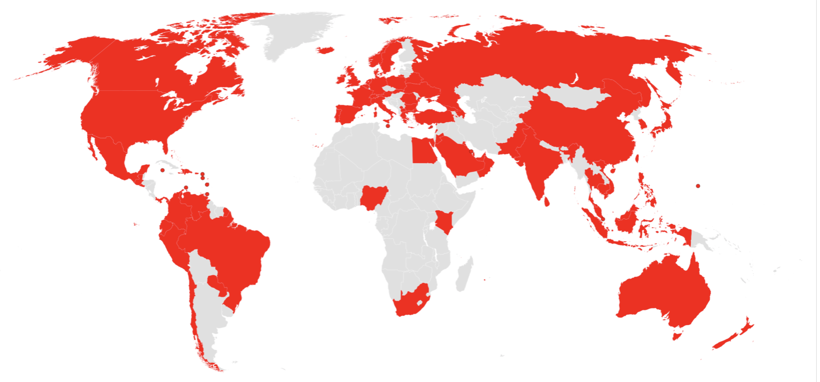
Comparision:
DoorDash
DoorDash is currently operating in over 4,000 cities in the United States, 80 cities in Canada, 3 in Australia and 1 city in Japan.
Domino's
In Quarter 1 of 2021 Domino's was operating 17,800 stores in more than 90 countries.
Benefits to DoorDash
DoorDash could leverage Domino's international footprint and customer base
Domino's International Footprint
Notes:
https://biz.dominos.com/about/fun-facts/
One of the items from our SWOT analysis opportunities was to expand globally. Currently DoorDash is in over 4,000 cities and town in the United States, 80 cities in Canada, 3 cities in Australia and 1 city in Japan.
Domino's had global retail sales of more than $16.1 billion in 2020, with nearly $8.3 billion in the U.S. and more than $7.8 billion internationally.
In the first quarter of 2021 Dominos was operating in more than 90 countries.
DoorDash could leverage Domino's international footprint and global customer base. Domino's knowing local laws etc will help DoorDash transition into the new areas

Slide 12
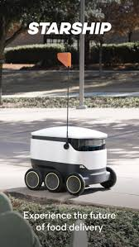
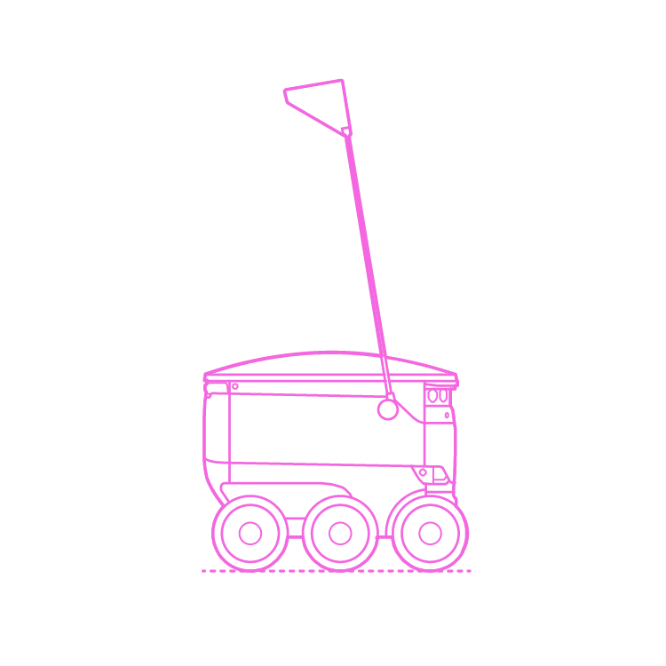

Acquistion Option:
Reasons for Acquistion Consideration
Continue to invest in innovative technology and delivery options to provide the most cost effective and efficient deliveries for their customer
Allow DoorDash the capacity of expanding to other areas with limited Dasher resources.
Improve the delivery experience for customers and merchants who are concerned with human error and tampering.
Notes:
Our third option of potential companies to acquire, would be Starship Technologies. Starship Technologies is best known for their autonomous delivery robots that deliver goods in school and work campuses as well as congested major cities. The reason why we are considering Starship Techonologies for acquistion, is to continue to invest in innovative technology and delivery options to provide the most cost effective and efficient deliveries for door dash customers. Acquiring Starship would allow door dash the capacity of expanding to other areas where there is limited dasher resources. Lastly, we are considering starship technologies because it would improve the delivery experience for door dash customer who may be concerned with receiving food not on time because of human error and deliveries that could be at risk of tampering by dashers.

Slide 13
Who is Starship?
Starship Technologies is revolutionizing deliveries with autonomous robots.
Designed to deliver Groceries, Food, Laundry, Medicine and packages in a 4 mile radius within minutes going as fast as a humans light jog.
Equipped with hot and cold compartments to help keep temperature controlled items safe.
To ensure accuracy of delivery, Starship Technologies invest heavily on mapping technologies to ensure the most accurate sidewalk and road conditions.
Engineer offices in Estonia and Headquartered in San Fransico, California.
Operating in UK, USA, Germany, Denmark, and Estonia
Starship Company History:
2011: Founded by the co-founders of Skype in June 2011.
2011: Registered first in Tallinn, Estonia
2016: Registered in the Unites States, establishing their headquarters in San Fransisco
2016: Launched Pilots in United States and the United Kingdom
2019: Partnered with its first college, George Mason University and distributed 25 robots to deliver food on campus.
2019: 25 other university campuses across the united states joined in utilizing starship as a way to deliver food on campuses.
2020: Let go of more than half of its employees in Estonia because of the covid – 19 pandemic
Early 2021: Rehired many of its staff as campuses have reopened post pandemic.
Notes:
Starship was founded in 2011 by the cofounders of Skype where it was first registered in Estonia. In 2016, Starship moved the company to the US and registered it as Starship technologies inc, a deleware corporation, and headquarted the company in san fransico california. They immediately started launching pilots of their autonomous robots in the US and in the UK, with commericial service tests launching later in 2017. In 2019, starship partnered with a company called Sodexo and started food delivery on George Mason University campus. With 25 robots in the Geroge Mason fleet, it became the largest fleet of autonomous delivery robots being used for food delivery on a college campus. Shortly after, it expanded its services on to 25 other college campuses in the US. In January 2021, Starship technologies annouced it has made over 1 million delivieries in the US.
Starship techonologies truly is revolotionizing deliveries for merchants everywhere. The robots are designed to deliver within a 4 mile radius and can travel at an average speed of 4MPH. If you remember from last week, our team proposed a strategy for Doordash to diversify their services. We spoke about Starship as being a great tactic to help implement this strategy. Starship Robots are equipped to deliver goods outside of just food, they are being used to deliver things like laundry, medicine, packages, and even groceries. Starship Technologies is investing heavily on mapping technologies at this time to ensure the most accurate sidewalk and road conditions to ensure smooth travel for their robots. These technology developments in mapping could also be of great use for DoorDash as they are also looking for the most accurate and real time description of road and sidewalk conditions.
Starship Technologies are currently opperating in the UK, USA, Germany, Denmark, and Estonia.

Slide 14
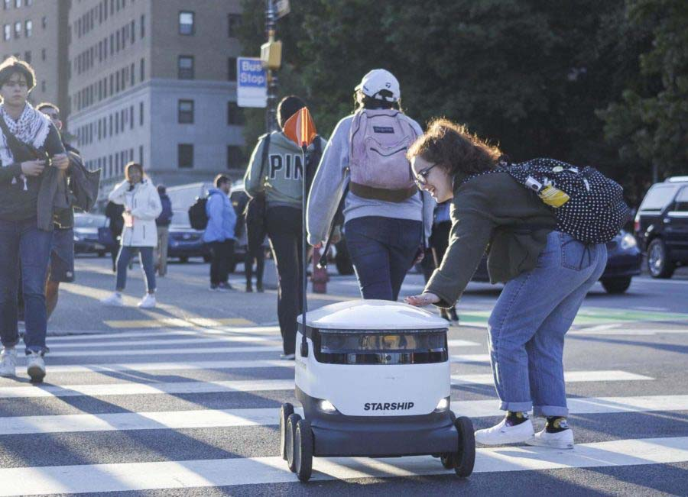
Why Starship?
Aligns with the DoorDash strategy to expand its delivery options and provide the most cost effective and efficient means of transporting goods.
Allows for more efficient delivery options in congested areas where parking and traffic may be an issue
More secure delivery from merchant to customer. With locked compartments to ensure no tampering of objects.
Temperature controlled compartments.
24/7 availability to deliver goods
Growing demand and autonomous restrictions being lifted by many states.
Starship is making large investments in having the most up to date and accurate mapping technologies.
Getting in early on the autonomous technology that can be expected to grow and develop over the years.
Operating globally
On work and college campuses, starship allows for DoorDash to expand services.
Libraries, transferring meeting documents from one building to another, food, medication, etc.
Notes:
DoorDash identifies as a technology company with a goal to connect people to the best merchants in their city. They believe that they are at the beginning of connecting people with new technology possibilities and even go as far as to say that Experimentation is in their DNA. Acquiring a technology company like Starship, doordash would be given the ability to expand their delivery options and provide the most cost effective and efficent means of transporting goods for the communities they serve.
We believe that Autonomous Delivery is the way of the future as more and more large companies like kroger, cvs, fedex, walmart, dominos,and several others are getting on board and investing in similar companies to starship to complete local deliveries. We are seeing autonomous delivery pop up in the news more frequently as states start reworking state regulations and make adjustments to policies for this new technology. Investing into a company like starship has potential for growth, as experts believe that this technology will continue to become more advanced as more companies begin to invest in its development. Starship would allow for more delivery options in congested areas where parking and traffic may be an issue. It also solves a common complaint of food arriving cold by having temperature controlled compartments that are secure from individuals tampering with the enclosed goods. Starship technologies would allow 24/7 delivery options, campuses could expand the utiliziation of these robots and use them for tranporting books from libraries, medicines from clinics when students are sick, and transporting important documents from one meeting or office space to another.
Next, I will hand this over to Jenifer to explain which acquisition we are recommending to move forward with.

Slide 15

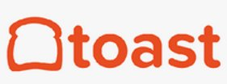
Adjacencies: Toast has products adjacent to DoorDash’s
Ability to Cross-sell and Grow Market Share: Expands DoorDash's supplier base and Toast's customer base
DoorDash can benefit from Toast's relationship with restaurants. 1 in 5 new Toast customers is a referral from an existing customer
Revenue and Cost Synergies
Both companies are technology companies that value analytics
DoorDash already integrates with Toast and Toast is already partners with DoorDash for delivery
Aligns with our Growth Strategy
Grow Market Share through Improved Relationships with Suppliers
Aligns with DoorDash's vision
"(to) create a set of services to grow a merchants sales."
Notes:
Out of our three acquisition proposals, we believe that Toast offers the most benefits to DoorDash and is the strongest opportunity. Toast aligns with DoorDash's vision "to create a set of services to grow a merchants' sales" and our growth strategy to "grow market share through Improved Relationships with suppliers." In our earlier slide I went into great detail the benefits of acquiring Toast but here are a few of the key items on the screen.
Adjacencies – Toast has products adjacent to DoorDash that market to potential and current DoorDash suppliers. This allows for cross selling, efficiencies in sales staff, and will result in better market share for both companies. Both companies think of themselves as technology companies and strongly utilize analytics which will help when merging the companies plus will lead to additional expertise and access to existing R&D. Toast possesses a reputation that DoorDash can benefit, and learn, from including their reputation with restaurants and with their own employees, they are known for a strong company culture. Lastly, the companies are already working together! Not only does DoorDash integrate with Toast currently but Toast has partnered with DoorDash to do their new delivery service.
If you are going to move forward with acquiring a new company, we Toast will offer the best ROI

Slide 16
Toast: Potential sale price and assumption from valuation.
Toast currently valued at $8 Billion as of Nov 2020, up from a $4.9 Billion valuation in February 2020.
Assumption from Valuation
Unconfirmed reports that Toasts discussed an IPO that could value the company at 20 Billion.
Many Restaurants joined Toasts platform last year, and the company's revenue grew 109 percent as a result.
Toast's growth is not sustainable with the market being saturated with companies providing the same service.
Toast has a very small share of the overall restaurant industry POS business.
Toast is overpriced and will fizzle by the time they IPO.
Potential Sale Price
We think a value of $10 Billion seems more likely and recommend offering $9 Billion.
Sale price is determined by Olo, a similar New York Based Company, that operates in the similar part of the restaurant company,
An article, Tech Crunch, revealed that anything above $5 Billion would be cream for them.
Olo revenue in 2020 of $98 million and profits of a little over $3 million.
Olo financial performance is not far-fetched from Toast, with a revenue of $284 million in 2020 from a $260 revenue in 2019.
S-1 filing revealed Olo had a history of loses and was unable to achieve or sustain profitability.
On March 17, 2021, Olo launched their IPO achieving a valuation of $3.6 Billion.

Slide 17
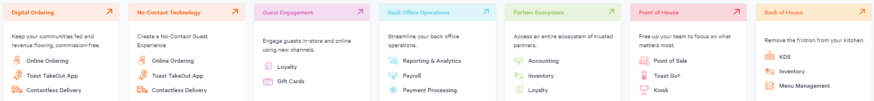
Implementation Considerations
Communication: Leadership, Operations, Software developers, Data teams, etc.
Keep Strategies clear
This acquisition is a strategy to Grow Market Share through Improved Relationships with Suppliers
This should integrate growth in markets, products, technology, and resources but should not completely reshape the active corporate strategies or vision in other areas
Win-Win: Ability to Cross-sell and Grow Market Share
Culture
Good fit - Honor the past, must let it evolve on its own
Both are: Fun, open, inclusive, experimental, promote hard-working environments - very restaurant/merchant first minded
Toast: Fortune's 2020 list of Best Places to Work in Technology - "bring your full self to work" and "no ego.“
The “Dashers” can learn from the “Toasters”
Integration
Organization structural integration depending on Toast CEO retention
Overlapping Areas: Properly align use of current DoorDash “Storefront” into Toast System and DoorDash service into Toast Delivery Services™
Processing fees (Toast is experimenting with a flat fee)
Collaborate data: Use data from both parties to increase efficiency between the order and food delivered
Others
Potential push back from restaurant owners frustrated with profitability issues that involve working with third-party services
Toast: Evolved into almost the Swiss Army Knife of restaurant tech platforms so DoorDash could eventually benefit from diversifying into the other areas below
Social Impact
DoorDash and Toast are using their platforms to address food insecurity, hunger, waste, inequality, and accessibility via Project DASH (DoorDash Acts for Sustainability and Hunger) and Toast’s “Enrich the food experience for all”
$165 billion worth of food is wasted every year. 16 million U.S. households go hungry. The strength of what they can do to help will multiply if acquired.
Success Measures
Key Success Metric: Number of new Restaurant Partners
Secondary Metrics:
Partner Satisfaction Score through surveys
% of restaurants increased their order count
% Market Share growth in the restaurant segment (key markets and overall domestic market share)
$ and % Revenue growth in the restaurant segment (key markets and overall)
Maintaining or reducing the number of competitors in markets
Notes:
Currently, they are a form of competitors in certain areas
So, leadership, Operations and everyone involved will need complete transparency throughout implementation
Since Toast is an adjacent business, the strength of this strategy would be to utilize their customers, suppliers and partnerships to “gain share from the “Buy Local” consumer segment, shift share from other delivery services, and reduce the odds of new local competition entering the market”
So this is an opportunity to GROW their markets, products, technology, and resources but NOT completely reshape the current corporate strategies that are already in place
Such as expanding globally and getting into logistics of delivering other products which I talked about last class.
In other words it would help combine core competencies to more easily gain ground on restaurant growth and technology (marketplace & point-of-sale)
We believe the culture will evolve on its own nicely considering the similarities of their workplaces.
Both portray a Fun, open, inclusive, experimental, promote hard-working environments and of course are very restaurant/merchant first minded
When it comes to Integration, Organization structural may have to be aligned, depending if the Toast CEO leaves
In overlapping areas of the business’, efficiency can definitely be improved along with processing fees.
However there is always some push back from restaurant owners frustrated with profitability issues that involve working with third-party services
So that’s something to look out for
And in addition to growing Market Share
DoorDash will also benefit from diversifying into the other areas Toast offers in the below chart
Social Impact is also an area where they are very aligned with their purposes to give back
They are both using their platforms to address things such as food insecurity, hunger and waste
And finally, here are the Key Measures mentioned last week that will ensure to keep
the success tracked
Thank you, this concludes our suggestion. Please let us know if you have any questions.

Slide 18
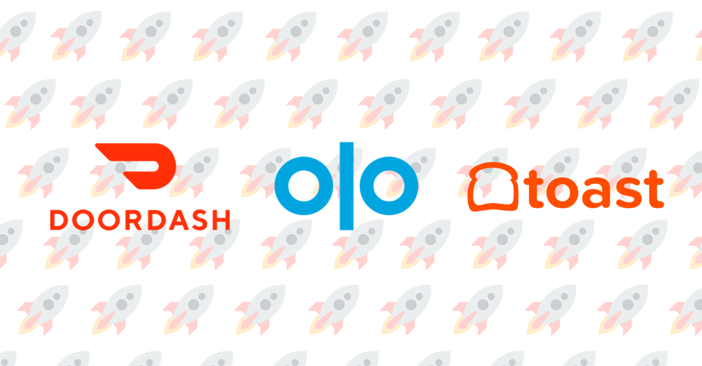
Questions?
Notes:
Alrightt Thank you, this concludes our suggestion. Please let us know if you have any questions. DoorDash and Toast to the moon!

Slide 19
References
http://proxy.library.vcu.edu/login?url=https://www-proquest-com.proxy.library.vcu.edu/wire-feeds/toast-inc-granted-patent-multi-restaurant-facial/docview/2475314788/se-2?accountid=14780
https://www-proquest-com.proxy.library.vcu.edu/docview/2490040239/958D497BC7264A53PQ/1?accountid=14780
https://get.doordash.com/blog/our-commitment-to-you
https://f.hubspotusercontent40.net/hubfs/4312591/Toast%20Mx%20Facing%20Guide%20V3.pdf
https://www.forbes.com/sites/petercohan/2021/02/22/after-50-april-staff-cut-toast-aiming-for-20b-ipo/?sh=2437caabb318
https://pos.toasttab.com/blog/restaurant-management-software
https://www.dominos.com/en/about-pizza/pizza-restaurant/
https://techcrunch.com/2021/02/24/understanding-toasts-expected-ipo-through-the-lens-of-olos-2020-results/
https://www.cnbc.com/2021/03/17/restaurant-tech-firm-olo-shares-soar-more-than-20percent-in-ipo-as-online-ordering-surges.html
https://www.marketwatch.com/story/olo-maker-of-restaurant-ordering-tech-prices-ipo-at-25-a-share-for-valuation-above-3-billion-11615945340
https://pos.toasttab.com/about
https://pos.toasttab.com/products/toast-delivery-services
https://www.forbes.com/sites/aliciakelso/2020/12/10/now-that-doordash-is-public-heres-how-it-plans-to-be-profitable/?sh=2e301c8b6472
Notes:
New links (old links in slide below in case you need to grab some)

